Slide 1
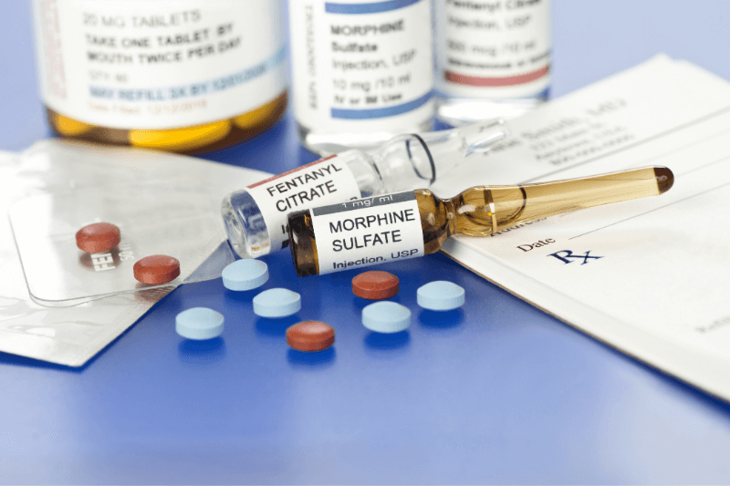
Controlled Substances and the Promotion of Access to Medicines: The Meeting Point
Presented by
Pharm. (Mrs.) Yedunni Adenuga
Director Narcotics and Controlled Substances Directorate
27th Annual Conference of the Association of Industrial Pharmacists of Nigeria (NAIP)
7th June 2024

Slide 2
Outline
Introduction
Definitions
Why are narcotics Regulated?
Control Strategies
Legal and Regulatory Framework
National Control Measures
Synthetic Drug Problem in Nigeria
Availability of Controlled Medicines for Medical use
Barriers to Access to Controlled Medicines
Promoting Access to, Availability and Affordability of Controlled Medicines
Traceability of Pharmaceutical Products
Conclusion

Slide 3
Introduction
Pain is the most common symptom that requires medicines, and therefore controlled medicines particularly the internationally controlled essential medicines command great attention as a means of reducing sufferings.
The World Health Organization (WHO) provides a universal essential medicines list that includes the medications considered to be most effective and safe to meet the most important needs in a health system.
Controlled medicines are made available for use in healthcare systems within a regulated environment. Regulations in the handling of controlled medicines are to ensure responsible access which ultimately promotes public health.

Slide 4
Introduction Contd.
A document released by the United Nations office of Drugs and Crime states the following facts
80%
150
5 BILLION
of the world’s population are without access to controlled medicines
Countries, both low- and middle-income countries as well as high income countries, have reported untreated severe pain.
People are living in countries with low or no access to controlled medicines for severe pain symptoms

Slide 5
Introduction contd.
Uganda and Nigeria have a reported unmet need for opioids for palliative care of 89.0% and 99.8%, respectively (Knaul et al., 2017).
Over 70% of cancer deaths actually occur in low- and middle-income countries. Without sustained action, cancer incidence is projected to increase by 70% in middle-income countries and 82% in lower-income countries by 2030.
Pain treatment is needed in many other medical situations (surgery, delivery, etc.).

Slide 6
Introduction (Contd.)
The 1961 convention recognizes that medical use of narcotics is indispensable for the relief of pain and suffering and that adequate provision must be made to ensure the availability of narcotic drugs for such purposes.
The adequate consumption of opioid analgesics is 200 S-DDD (defined daily doses for statistical purposes). Nigeria has <1 (INCB and Berterame 2016).
Other internationally controlled drugs such as methadone and buprenorphine (an opioid analgesic which is controlled under the 1971 Convention and whose use in substitution therapy continues to increase) are used in the management of drug dependence and their use is also limited in some countries despite considerable prevalence of heroin abuse.

Slide 7
Definitions
Narcotics
Derived from the opium and its derivatives which include morphine and codeine.
Derived from cannabis and coca leaf plants.
Also included are synthetic Narcotics, such as Pethidine, Fentanyl, and Methadone
Legally they are substances contained in Schedule I, II, III and IV of the UN 1961 Single Convention on Narcotics as amended. The differences in the scheduling relate only to the control measures to be applied.
The medicines are indispensable for the relief of pain and the convention seeks to make them adequately available for medical and scientific purposes only.

Slide 8
Definitions
Psychotropic Substances
Drugs that alter the central nervous system such as sedatives, hypnotics, hallucinogens and stimulants. Under the UN Convention on Psychotropic Substances of 1971, these substances are listed under Schedules I, II, III, and IV.
Some of these medicines are employed in anaesthesia for surgical procedures (such as thiopentone and midazolam), essential in emergency obstetrics (ergometrine) or used as anxiolytics and hypnotics (benzodiazepines) or as antiepileptics (phenobarbital and benzodiazepines).

Slide 9
Definitions
Precursors
Raw materials which when used in the production of a drug become part of a finished product.
Reagent and Solvents are also listed as precursors but usually not a part of the finished product. They are however used in the manufacture and processing of some Narcotic drugs and psychotropic substances. Examples are ephedrine used in the manufacture of methamphetamine; sulphuric acid is a reagent and acetone is a solvent.

Slide 10
Definitions
United Nations (UN) Conventions
The International drug control conventions were enacted to promote better health.
Written legal agreements between countries and the UN. When a government signs a convention, it becomes legally bound to uphold those standards.
The UN enact these legal agreements, countries choose whether to adopt them or not. States are expected to domesticate the provisions of the international conventions into national legislation.
.

Slide 11
Definitions
Policy
A set of policies are principles, rules and guidelines formulated by government to reach its long-term goals and typically published in a booklet or other form that is accessible
Regulations
A set of rules on a specific topic with binding legal force at the national, state or local level and enacted by an administrative body to which the authority to issue such rules have been delegated by national state or local legislative body.
Guidelines
Applicable rules, guidance, manuals, protocols, codes, guidelines, treaties, notices, directions or requirements to the extent that the foregoing do not have the force of the law

Slide 12
Definitions
Accessibility
The degree to which a medicine is obtainable for those who need it at the moment of need with the least possible regulatory, social or psychological barriers.
Availability
The degree to which a medicine is present at the distribution points in a defined area for the population living in that area at the moment of need,

Slide 13
Definitions
Affordability
The degree to which a medicine is obtainable for those who need it at the moment of need at a cost that does not expose them to the risk of serious negative consequences as not to be able to satisfy other basic human needs.

Slide 14
Why are Controlled Medicines Regulated?
In-dispensable for medical, scientific and industrial purposes, yet have high abuse potential.
Nigeria is a signatory to the three international conventions which provide framework for the control of narcotic medicines, psychotropic substances and precursors for medical, scientific, and industrial purposes only, while preventing diversion.
Thus these substances are controlled under international conventions and or national procedures.

Slide 15

CONTROL STRATEGIES
United Nations International Drug Control Conventions
Single Convention on narcotic Drugs 1961 as amended by the 1972 protocol
Convention on psychotropic Substances 1971
Convention Against Illicit Traffic in narcotic Drugs and psychotropic Substances 1988
INTERNATIONAL CONTROL
NATIONAL CONTROL

Slide 16

CONTROL STRATEGIES
The mandate of the International Conventions is:
To ensure that controlled medicines are available for medical and scientific purposes.
To prevent diversion into illicit channels
The International Narcotics Control Board (INCB)
The independent and quasi-judicial monitoring body for the implementation of the United Nations international drug control conventions.
Monitors and supports Governments’ compliance with the international drug control treaties

Slide 17
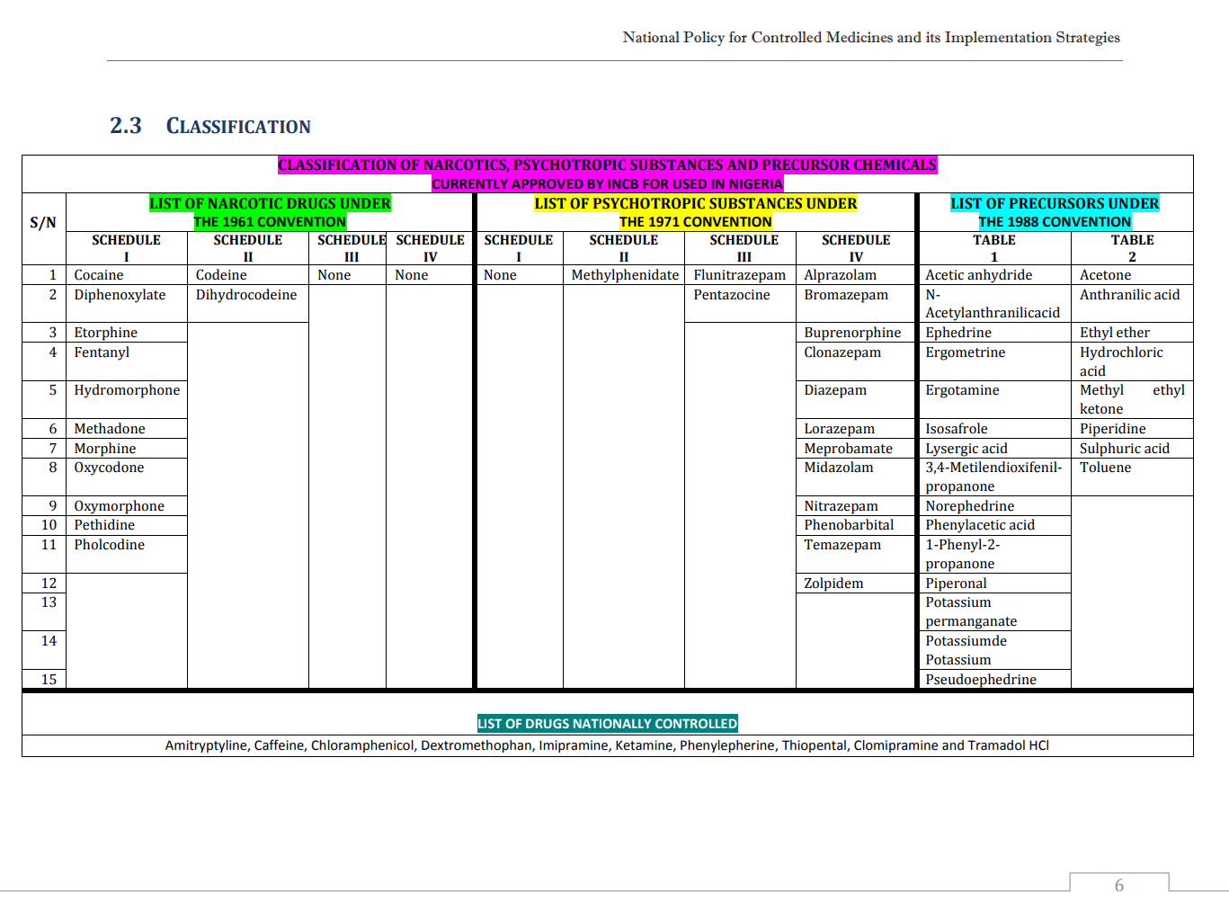

Slide 18
Internationally controlled essential medicines and their therapeutic uses
Therapeutic use | Medicine
Anaesthesia | Lorazepam, midazolam, morphine
Anti-epileptic | Diazepam, lorazepam, midazolam, phenobarbital
Anxiety disorders | Diazepam, lorezapam, midazolam
Hypotension (anaesthesia) | Ephedrine
Opioid agonist | Buprenorphine, methadone
Pain and palliative care | Codeine, diazepam, morphine, methadone
Procedural sedation | Fentanyl, lorazepam, midazolam
Topical anti-infective | Potassium Permanganate
Utetronic | (Methyl) egometrine

Slide 19
CONTROL STRATEGIES
National Control of Narcotics
In Nigeria, the control, availability and access to narcotics, psychotropic substances and other controlled medicines are guided strictly by aforementioned Conventions and the following policies and legislations.

Slide 20
CONTROL STRATEGIES
The National Drug Policy
The document states the strategies to achieve the national goals, specifically the availability and affordability of essential medicines, as well as stimulation of local production of essential medicines.
The National Policy for Controlled Medicines and its Implementation Strategies
Approved by the National Council on Health meeting in November 2017
Formally presented to the public on 5th February 2018
UNODC implemented project sponsored by the EU.

Slide 21
Control Strategies
The National Policy for Controlled medicines and its implementation Strategies 2017
Goal
Ensure sustainable availability and accessibility to affordable controlled medicines for medical and scientific purposes, while preventing diversion
Objectives
Some of them are;
Ensure adequate importation, manufacture and supply of controlled medicines in Nigeria.
Ensure availability of the controlled medicines for use in healthcare delivery, across the full spectrum of health services in rural and urban areas, for private and public health services, and at all levels of the healthcare system in Nigeria.

Slide 22
Control Strategies
The National Agency for Food and Drug Administration and Control Act Cap N1, Laws of the Federation of Nigeria (LFN), 2004;
Controlled Medicines Regulations 2021
Poison and Pharmacy Act Cap 535 LFN, 1990
Dangerous Drug Act Cap D1, LFN, 2004
National Drug Law Enforcement Agency Act, Chapter N30, LFN, 2004.
Pharmacy Council of Nigeria (Establishment) Act 2022

Slide 23

LEGAL & REGULATORY FRAMEWORK
NAFDAC was established by Decree No 15 of 1993 (Now NAFDAC Act Cap N1 LFN 2004) to regulate and control the Importation, Exportation, Manufacture, Distribution, Advertisement, Sale and Use of food, Drugs, Cosmetics, Medical Devices, Chemicals, Detergent and Packaged water (known as regulated products)

Slide 24

LEGAL &
REGULATORY FRAMEWORK
The mandate - Part II No.5: j, k, l of the NAFDAC ACT
J -Undertake measures to ensure that the use of narcotic drugs and psychotropic substances are limited to medical and scientific purposes;
K- Grant authorisation for the import and export of narcotic drugs and psychotropic substances as well as other controlled substances;
L- Collaborate with the National Drug Law Enforcement Agency in measures to eradicate drug abuse in Nigeria;

Slide 25
NATIONAL CONTROL MEASURES
To achieve cost-effective and cost-efficient systems such that narcotic drugs psychotropic substances and precursors are available and accessible for medical, scientific and industrial use, while preventing abuse of drugs and the diversion of precursors to illicit use in the clandestine manufacture of controlled substances.
A DELICATE
BALANCING ACT
ACCESS
CONTROL

Slide 26
Synthetic Drug Problem in Nigeria
Tramadol
Trafficking and abuse of tramadol, a synthetic opioid not under international control, are of growing concern in Nigeria.
The widespread non-medical use of opioids is alarming with recent price increases, could be worth over S10billion annually.
Millions of Nigerians are daily non-medical users of highly addictive pharmaceutical opioids.
Tramadol a synthetic opioid is not in itself an illicit drug but it is widely used non-medically in Nigeria.
No legitimate manufacturer should be producing tramadol in doses higher than 100mg for export to Nigeria including local manufacturing.

Slide 27
Synthetic Drug Problem in Nigeria
Ephedrine and Pseudoephedrine
These items are used in the illicit manufacture of methamphetamine.
The annual legitimate requirements for psychotropic substances and some precursors were reviewed with the assistance of the UNODC. Allocations for permits for these items are being strictly done with returns being made to INCB by NAFDAC.
Despite this, there has been reported diversion of Ephedrine into illicit channels. This is evident by current seizures reported by NDLEA in recent times
The illicit ephedrine supply is diverted from licit imports into other West African countries.

Slide 28
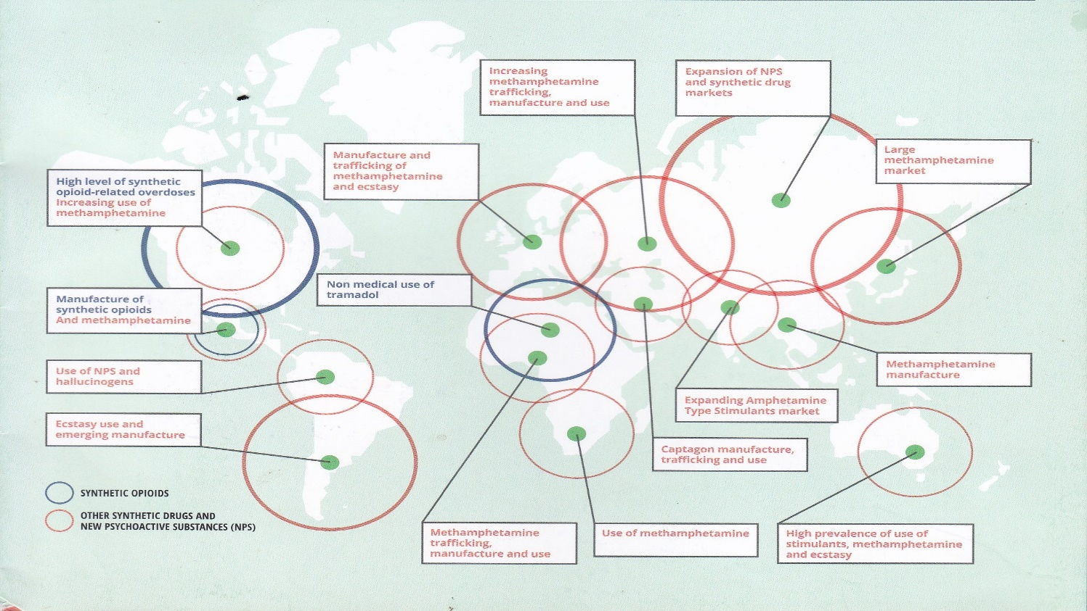
Synthetic Drug Problem in Nigeria

Slide 29
Availability of Controlled Medicines for Medical Use
INCB strives, in cooperation with Governments, to maintain a lasting balance between supply of and demand for raw materials needed to manufacture narcotics and other controlled medicines.
The amount of opiate raw material available for the manufacturing of narcotic drugs for pain relief is more than sufficient to satisfy the current level of demand as reported by Governments.
Governments and societies are mandated through the International Drug Control Conventions to ensure adequacy of controlled medicines, such as narcotic analgesics, while establishing procedures aimed at preventing diversion and non-medical use.

Slide 30
BARRIERS TO ACCESS TO CONTROLLED MEDICINES
Ooms et al. 2023, did a scoping review aimed at identifying the barriers to accessing Internationally Controlled Essential Medicines (ICEMs) across all relevant healthcare fields in Sub-Saharan Africa (SSA).
The following were the highlights
Lack of knowledge of the public and health workers on controlled medicines.
Low availability, stockouts and unaffordability of the medicines were common.
Lacking quantification systems and cumbersome procurement processes hamper access.
Strict national laws lead to overly restrictive prescription practices.

Slide 31
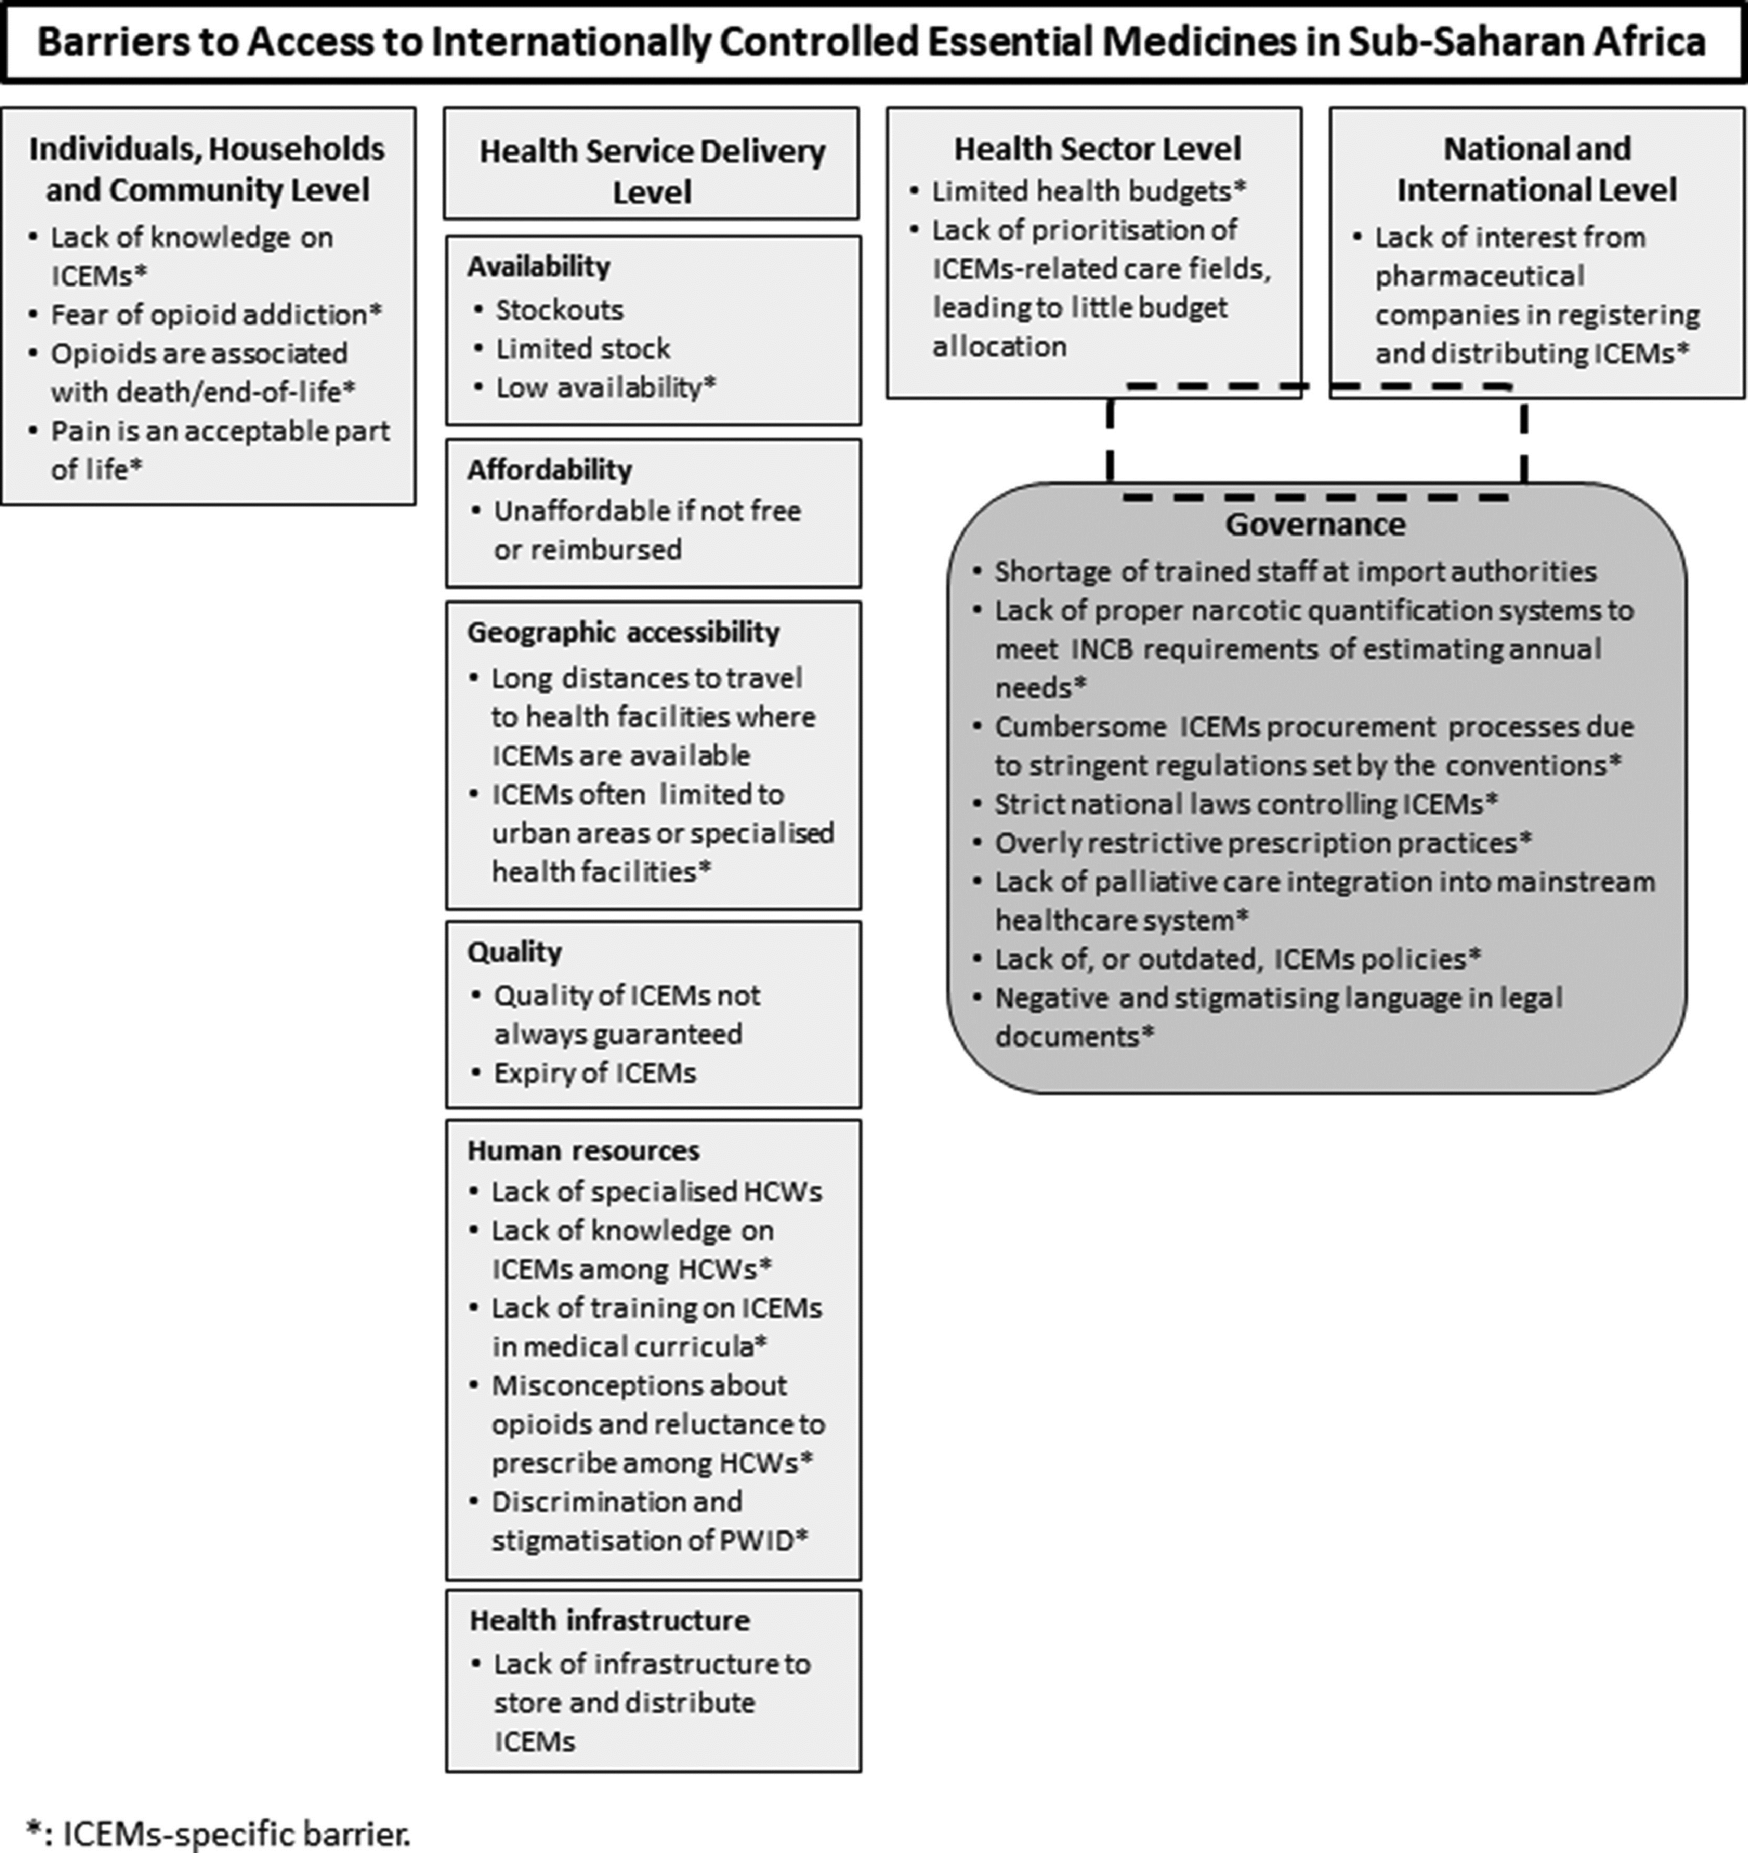



Ooms et al., 2023

Slide 32
BARRIERS TO ACCESS TO CONTROLLED MEDICINES
From the Nigerian Pharma Industry, the following may be deduced
Lack of interest from pharmaceutical companies in registering, manufacturing and distributing ICEMs
Lack of proper narcotic quantification to meet INCB requirement of estimating annual needs
Lack of palliative care integrated into mainstream health care system
Over-reliance on importation.
More than 90% of controlled medicines are imported. Only 3 companies produce injectable pentazocine. About 12% oral tramadol is produced locally . All injectable tramadol is imported
Profit-driven rather than patient-care driven.
Influence of the open-markets in Nigeria, where non-pharmacists (particularly holders of PPVL) sell virtually all categories of drugs including narcotics and controlled substances.

Slide 33
Promoting Access to, Availability and Affordability of Controlled Medicines
Core Areas: increasing access to and availability of controlled medicines requires the integration of actions within three “core areas”
Cross-cutting themes are aspects of the 3 core areas that overlap or that tie the issues together. These themes are crucial to identify actions and strategies within the core areas
Data and research
Patient-centred care
Prevention of diversion and non-medical use
Consistent messaging
Economic Structure
For medical purposes
Preventing Diversion
Preventing non-medical use
Education and Awareness raising
System Strengthening and Integration
Supply Chain Management

Slide 34
Promoting Access to, Availability and Affordability of Controlled Medicines
The Three Core Areas
Education and Awareness Raising
Basic training on the science behind the use of controlled medicines, including narcotics and psychotropic medicines in our curriculum and in our establishments.
Well as a full understanding of the drug control system with mechanisms to prevent diversion and misuse.
Mandatory continuing education on controlled medicines
Support the development or strengthening the professional associations related to pain management and palliative care.

Slide 35
Promoting Access to, Availability and Affordability of Controlled Medicines
System Strengthening and Integration
Public health systems: Assessment of patients, prescriptions, filling of prescriptions. A strong public health system will be reflected in the private space.
Drug regulatory systems: include all aspects of managing the requirements of the three International Drug Control

Slide 36
Promoting Access to, Availability and Affordability of Controlled Medicines
System Strengthening and Integration
It is important to note that these two systems are inherently connected since the International Drug Control Conventions govern the production, manufacture, distribution, storage, and consumption, of all medicines designated as having an “abuse potential.”
Other Local and National Systems that need to be integrated include the educational, judicial, financial, labour systems etc

Slide 37
Promoting Access to, Availability and Affordability of Controlled Medicines
Supply Chain Management
Supply chain is a series of interactions designed to move a product, in this case, controlled medicines, from the initial phase to the end-user or patient.
Effective supply chain management in this case includes oversight of the controlled substances that cultivated, manufactured, distributed and consumed for medical and scientific purposes. That product may be manufactured nationally, or imported.
A set of policies and regulations are applied to maintain a strict inventory control in compliance with the three International Drug Control Conventions.

Slide 38
Promoting Access to, Availability and Affordability of Controlled Medicines
5 Cross-Cutting Themes
Economic Structure
Building more capacity for the manufacture of controlled medicines in country.
Ensure that essential medicines that are controlled are covered in National Health Insurance Scheme.
Sanctions on non-regulated markets that make medication available to patients outside the current supply chain

Slide 39
Promoting Access to, Availability and Affordability of Controlled Medicines
Consistent messaging.
Match the legislation with the existing policies in hospitals and pharmacies with a consistent message the increases the access to and availability of controlled medicines for patients.
Develop sector reports that dispel myths around the use of controlled medicines and can be used to encourage a consistent policy and practice message.
Differentiate between a policy and practice.

Slide 40
Promoting Access to, Availability and Affordability of Controlled Medicines
Patient Centered Care
We should be patient oriented rather than profit-driven. These principles will guide the industry in diversion and fuelling the non-medical use of controlled medicines.
Areas of focus
Children and adolescents
The treatment of pain in children and adolescents is inadequate and under-researched. Less than 10% of the children who need pain medications in the world receive it.
Women/ pregnant women
The majority of medical treatments have been developed to meet the needs of adult men. This significantly limits women’s access to treatment and services.

Slide 41
Promoting Access to, Availability and Affordability of Controlled Medicines
Older persons
Healthcare issues of older persons and challenging and under-researched.
Adequate palliative care and pain treatment allows older persons to live with dignity up to and through chronic conditions and terminal illness.
Patients with special needs
Patients with mental health and substance use disorders, sickle cell and other health conditions that require the use of narcotic and other controlled medicines.

Slide 42
Promoting Access to, Availability and Affordability of Controlled Medicines
Prevention of Diversion and non-medical use
Use of electronic platforms to track products at every step of the supply chain
Build strong policies to report suspected fraudulent medicines with a framework of pharmacovigilance.
Analyze the markets to determine demand for controlled medicines that is being met outside the regulated market.
Analyze the pharmaceutical company role in promoting medication, including new products that may be marketed as abuse resistance.

Slide 43
Promoting Access to, Availability and Affordability of Controlled Medicines
Data and Research
The importance of collecting data and supporting the research to drive evidence based practice cannot be overstated. As Albert Einstein said, “If we knew what it was we were doing, it would not be called research, would it?”.
Prioritize the collection of accurate data at all levels of the healthcare system.
Use of technology or mobile monitoring using specialized Apps to capture data points.
Engage the academia with an interest in this topic to monitor and research the strategies implemented with a goal to publish results in a peer reviewed journals.

Slide 44
Promoting Access to, Availability and Affordability of Controlled Medicines
Data and Research
Invest in research and development. Research is not only in company’s products but in other healthcare related data as a corporate social responsibility. This will strengthen the role that the pharmaceutical society plays in collecting and monitoring data and other trends.
Develop new combination therapies and other specialized formulations.

Slide 45
Traceability of Pharmaceutical Products
FMoH launched a National Traceability of Pharmaceutical Products in 2020.
NAFDAC implemented this policy with COVID-19 Vaccines in 2020 and it was successful.
The implementation is now been extended to Narcotic Medicines.
Sequel to the above, each pharmaceutical premises is required to register her location with Global Standard (GS 1) Nigeria and obtain a Global Location Number (GLN).
Market Authorization Owners are to obtain Global Trade Identification Numbers (GTINs) for their products.

Slide 46
Traceability of Pharmaceutical Products
NAFDAC has deployed Track and Trace as a regulatory tool to monitor the distribution of narcotic products along the supply chain using GS1 standards. This was commissioned 18th January 2024.
All narcotic products will henceforth carry a 2Dmatrix barcode to be able to create shipping and receiving events.
The purpose is to be able to track these products from the manufacturer to the end user.
This will help reduce incidences of drug abuse and diversion to illicit channels.
All narcotics and controlled medicines are going to be tracked along the supply chain.

Slide 47
Conclusion
Narcotics and other controlled medicines must be accessed for their positive actions while making concerted efforts to prevent non-medical use and diversion to illicit channels which poses serious threat to individuals and the entire society.
A balance must therefore be struck between medical and regulatory requirements. To adequately address the need for narcotics and controlled medicines and prevent potential harms, non-medical use and diversion, proper regulation of controlled medicines needs to be enforced.
Local manufacturing is therefore the meeting point in ensuring that controlled medicines are accessible, available and affordable.

Slide 48
References
Knaul et al., 2017 Alleviating the access abys in palliative care and pain relief- an imperative of universal health coverage: The Lancet Commission Report. The lancet (2017), 10.1016/S0140-6736(17)32513-8
National Policy for Controlled Medicines and its Implementation Strategies FMOH Nigeria 2017
Ooms et al., 2023 Barriers to accessing Internationally Controlled Essential Medicines in sub-Saharan Africa: A scoping review https://doi.org/10.1016/j.drugp.2023.104078
Technical Guidance on Increasing Access to, and Availability of Controlled Drugs for Medical Purposes: Key Areas of Focus Advanced Draft March 2018
Organized Crime in Nigeria: A Threat Assessment – UNODC & NISS 2022S
www.incb.org
www.nafdac.gov.ng

Slide 49


